Slide 1
BC Surgical Wait Analysis 2009-2020
Group 1022 Data 301 April 13, 2021
Rynelle Desouza Akshaj Srinivasan Monica Penner (Bsc Md)

Slide 2
BC Surgical Wait Analysis -Objectives
Why researching surgical wait data is important
What are some important research questions related to this topic
Understanding our Data Sources
Preview and tour our BC Surgical Waitlist Dashboard
What we learned from the Data

Slide 3
Why is Wait Data Important
Waiting for surgery has been shown to have negative effects
Monitoring completed surgeries and surgical Waitlists and Wait Times are key markers of health systems
Minimizing surgical waits are important factors in keeping populations healthy and productive
Key definitions:
Waitlist: A tally of cases/patients who have been booked for surgery but have not yet had surgery completed
Wait Time: The duration of time that a patient/case is on the waitlist (the time spent between surgical booking and surgical completion

Slide 4
What Should We Know About Waits in BC
A Commitment to Surgical Renewal in BC
Introduced by BC Ministry of Health in May 2020
“ambitious” plan to reduce surgical waitlists
First step → Increase the number of surgeries performed/completed in BC
Does increasing surgical completions reduce the surgical waitlist?
Does increasing surgical completions reduce surgical wait times?

Slide 5
Data Sources
Government of British Columbia Data Catalogue
2009-2020 Annual Surgical Wait Times
Excel File direct download
https://catalogue.data.gov.bc.ca/dataset/7c1bf2a8-96bb-4ad5-888d-a90672eb306e/resource/6cd508eb-7e31-4c86-b070-dc698131fa9a/download/2009_2020-annual-surgical_wait_times.xlsx
Health Authority Boundaries
Geojson File –ordered link
https://catalogue.data.gov.bc.ca/dataset/health-authority-boundaries
Open Government License -BC

Slide 6
Data Description
Metrics: 10 Columns with 30266 Indexed rows
Pertains to: Number of Completed Surgical Cases
Number of Cases/Patients on the Waitlist for Surgery
Wait Times –Median
Wait Times -90th Percentile
Columns: Year (year), Health Authority (HA, h_a), Hospital (hosp),
Surgical Procedure (prcd), Waitlist (waiting), Completed Surgeries
(comp), Median Wait Time (wait_med), 90th%ile Wait Time (wait_90)
Duplicates: Because the data has summation rows for “All Health Authorities”, “All Facilities” and “All Procedures”

Slide 7
Dashboard Tour
Key Features
Map by Health Authority
Colour Coding -map/connectivity assists colour blind individuals
Filters : Health Authority, Procedure, Year
Graphs: Timeline trends, Procedure comparisons, Hospital comparisons
Connectivity allows for in depth analysis of specific hospitals
Research Questions

Slide 8
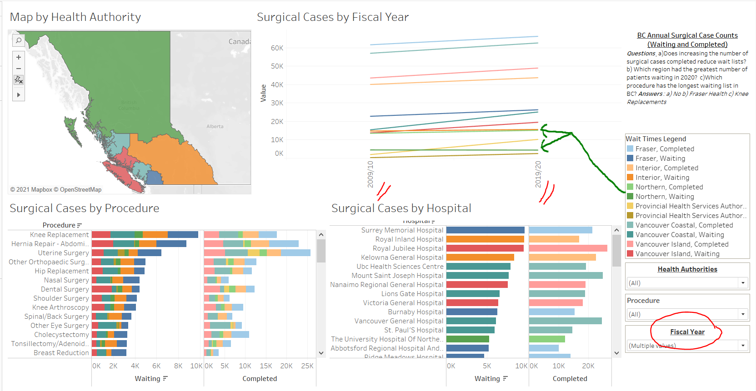
Does increasing surgical completions reduce the surgical waitlist?
NO!!!

Slide 9
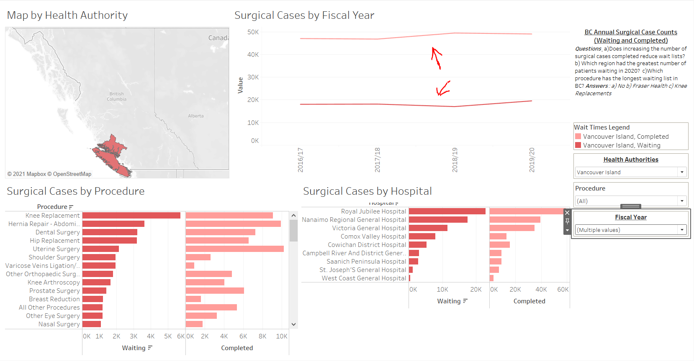
…but….possibly

Slide 10
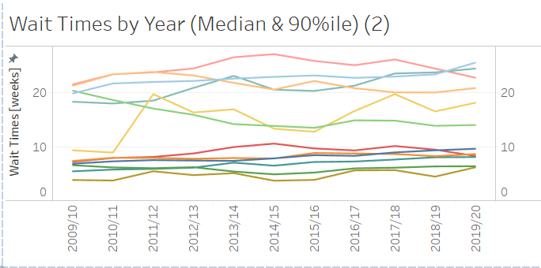
Does increasing surgical completions reduce surgical wait times?
NO!!!

Slide 11
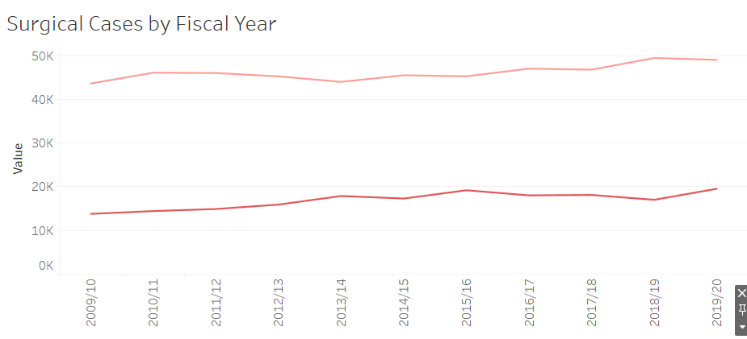
Vancouver Island Trends

Slide 12
Summary
This needs to be filled in but I am done for today…

